Slide 1
Final Project Milestone
Week 3 Update
Trevor Lau, Jenna Rutberg, Celine Semaan, & Alexander Williamson

Slide 2
Our Final Design
An object dropped triggers catapult.
Light-weight ball is launched where it hits a ball sitting on top of the hill located prior to the loop. Ball begins to move down hill, around loop and through track.
From loop and track, the ball reaches the drawbridge. The ball goes up to the top of the drawbridge and knocks over a container with object which is added to wedge and box. This object also knocks over dominoes which press button to open drawbridge.
Ball goes through opening, and reaches ferris wheel. Ferris wheel is constantly spinning and delivers ball to lower track.
Ball rolls from ferris wheel past LED into basket of pulley.
Added pressure of ball in basket lowers the basket to press a button. This button starts the motor for the pulley. Basket is brought up until hits track which tilts basket. Ball falls out of basket onto track.
Ball rolls from track into wedge and box. With added pressure from second ball, the button on the box is pressed.
The box opens, and door of box lands on button which starts the robot car. The robot car is programmed to circle the merry-go-round causing it to spin.
The final task of the box opening and merry-go-round spinning is achieved.

Slide 3
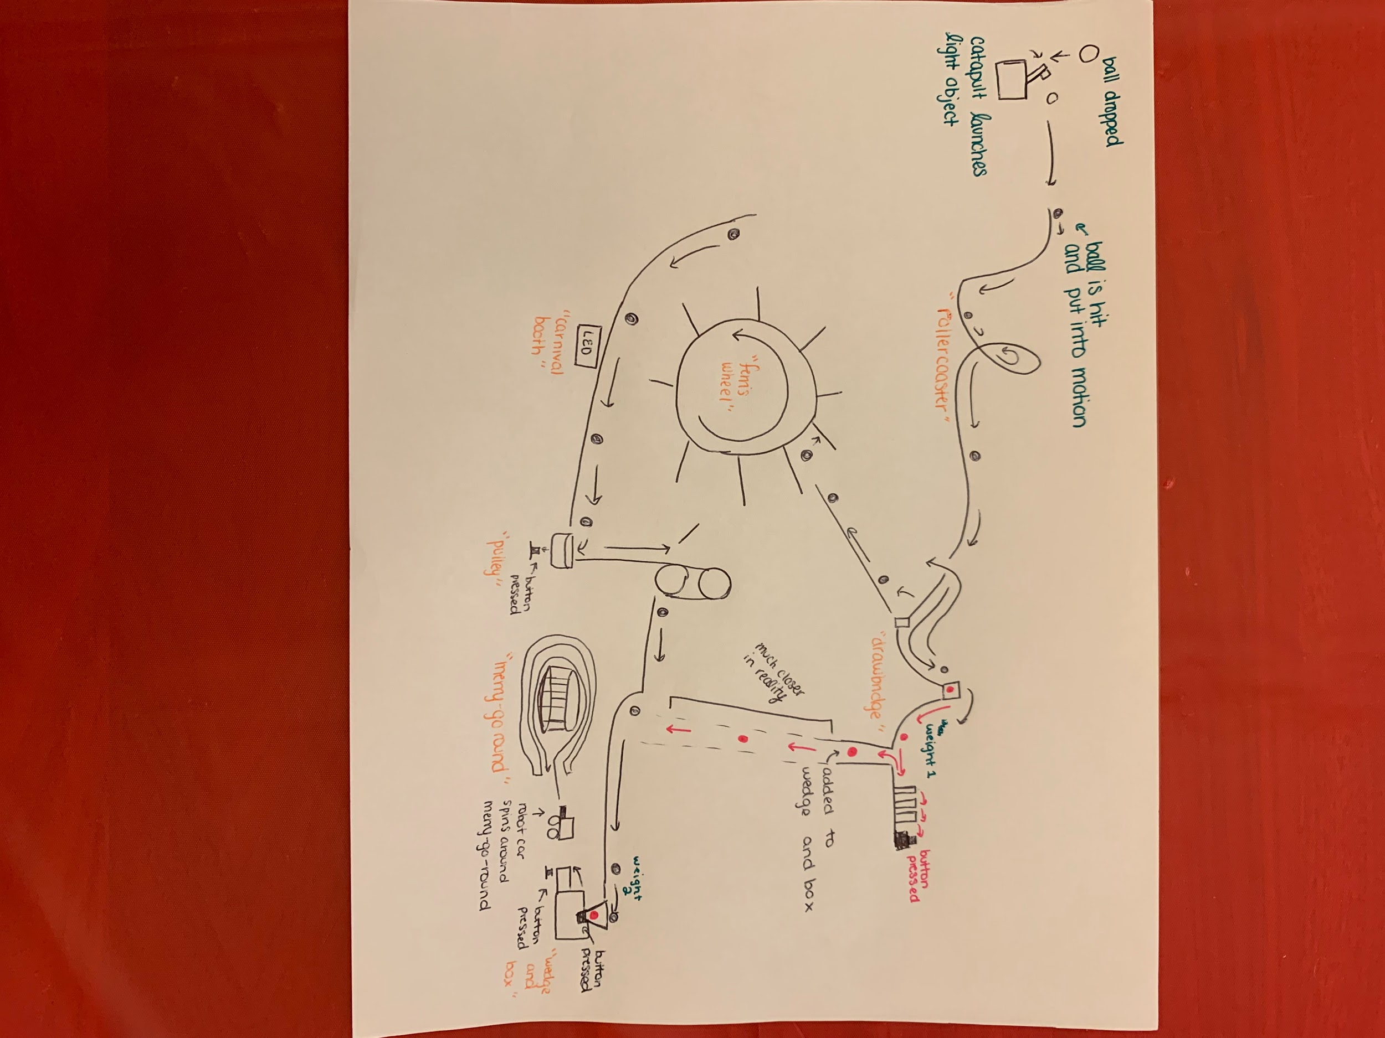
Final Design Plan

Slide 4
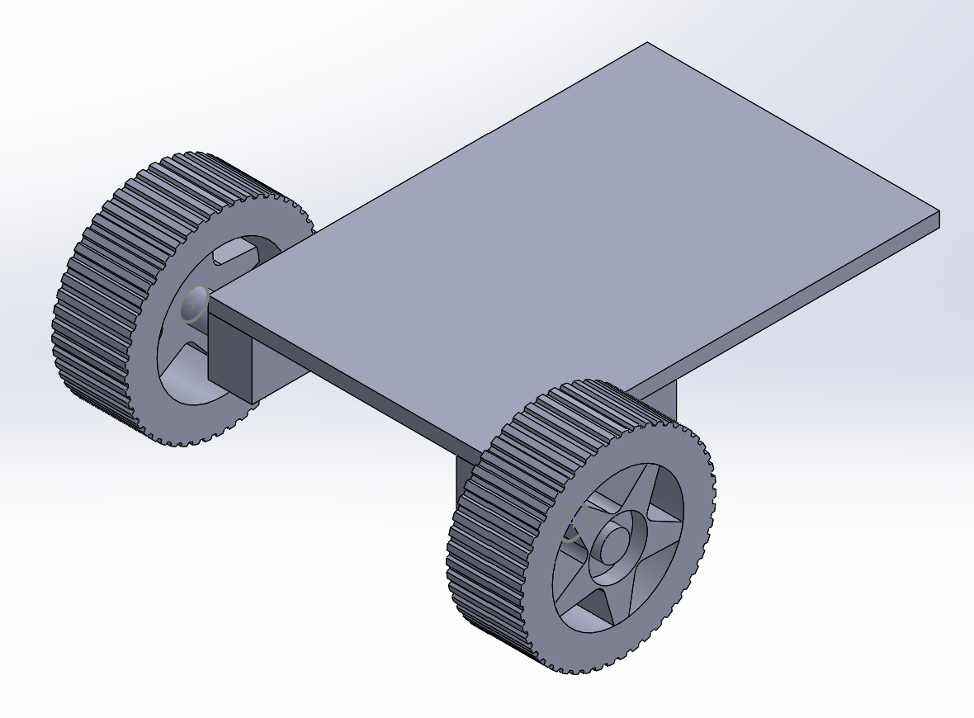
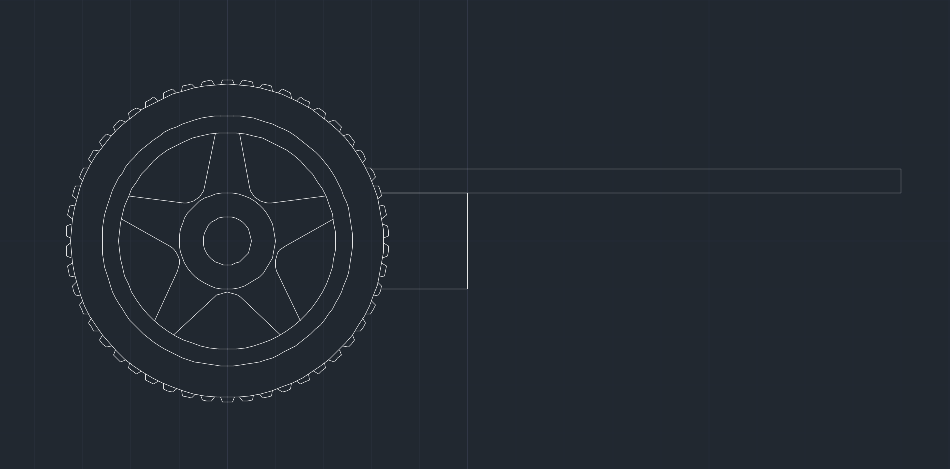
Updated Drawings
We kept many of our drawings from last week as we still are in the midst of physically building the machines.
We did add a drawing of the robot car.

Slide 5
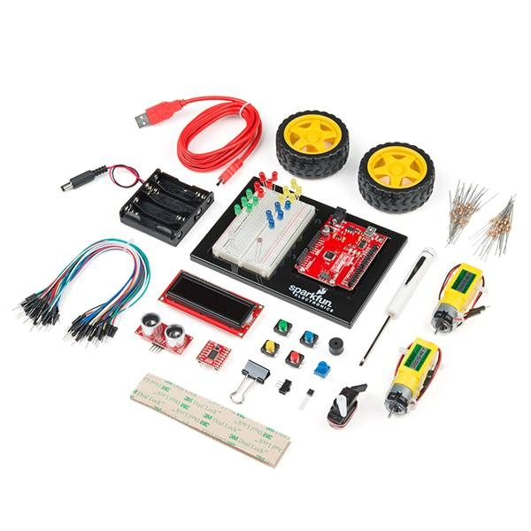
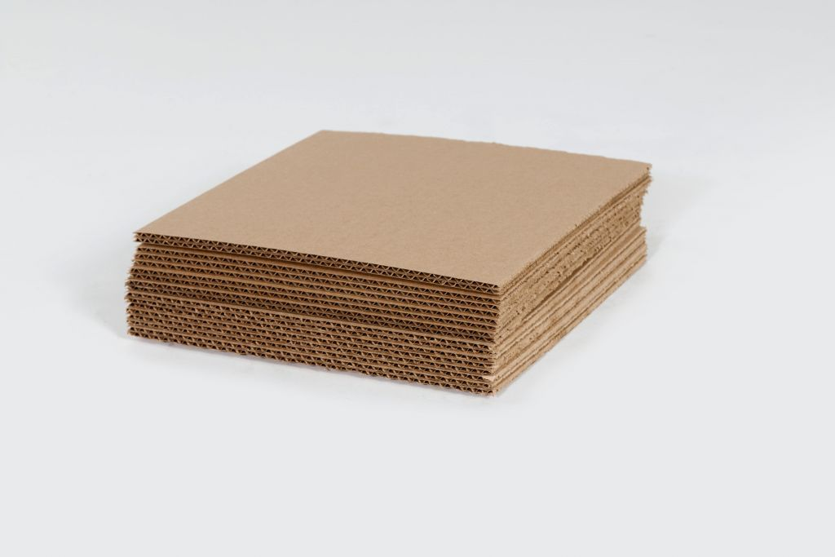
Materials
What we have collected…
Duct Tape
Ruler
SparkFun Kit (4)
Motors
Buttons
String
Popsicle Sticks
Hot Glue
Box with button
What we need…
Marbles (2)
Cardboard
Construction Paper
Light-Weight Ball
(4) AA Batteries
Notes:
Picture Link:
https://smhttp-ssl-80457.nexcesscdn.net/media/catalog/product/cache/40e4e078f3d1da2e3d1b4882c2ed0c73/5/6/566d3d31-9cb9-4f0b-816f-d6c4f4a4718e_corrugated-layer-pads-a.jpg
https://www.google.com/url?sa=i&url=https%3A%2F%2Fwww.generationrobots.com%2Fen%2F402824-sparkfun-inventor-s-kit-v40.html&psig=AOvVaw1dX255e_r3fqnM4sDsOwE6&ust=1606250828351000&source=images&cd=vfe&ved=0CAIQjRxqFwoTCLikuuLEme0CFQAAAAAdAAAAABAK

Slide 6
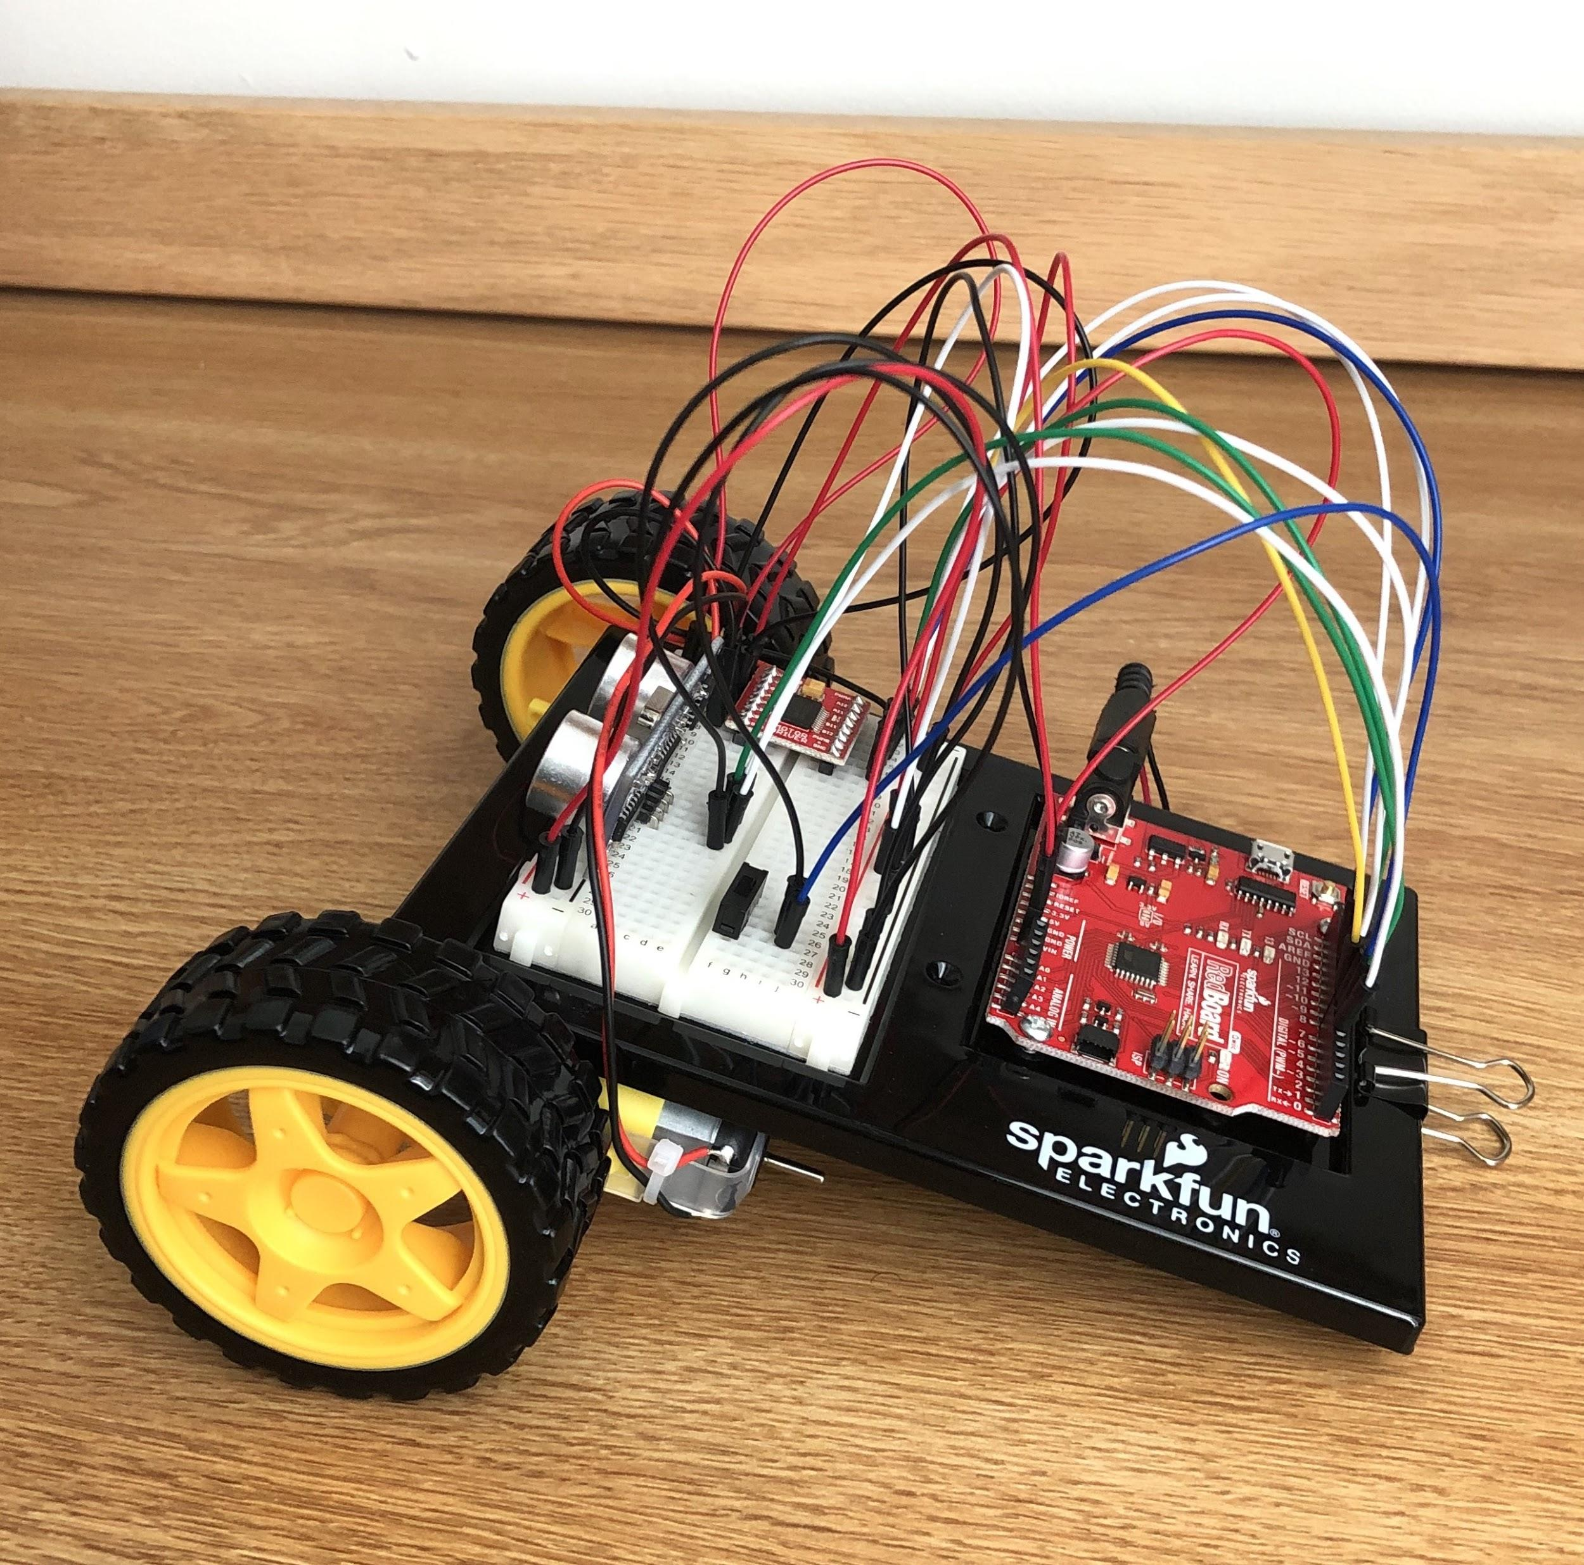
We have been working on...
We are in the middle of prototyping and building our simple machines.
We plan to have each machine mostly done by next week to allow for improvements of our designs to be made.
Robot Car

Slide 7
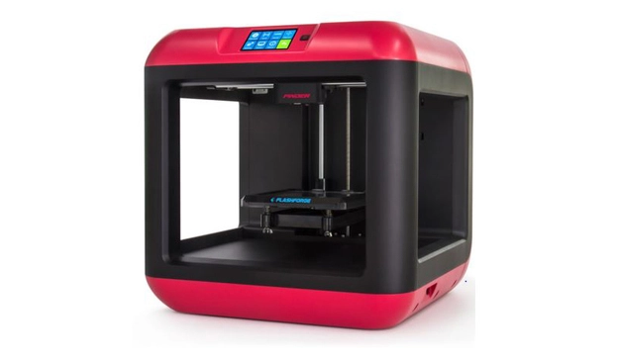
Our Plan for Graphic Test Two
Our four drawings will be:
Catapult
Ferris Wheel
Pulley
Robot Car
We plan to 3D print the pieces needed to assemble the pulley.
Notes:
Picture Link:
https://www.google.com/url?sa=i&url=https%3A%2F%2Fwww.pcmag.com%2Fpicks%2Fthe-best-cheap-3d-printers&psig=AOvVaw1dH5a55clmSb5wQqgqGNfW&ust=1606246821056000&source=images&cd=vfe&ved=0CAIQjRxqFwoTCLCmxeu1me0CFQAAAAAdAAAAABAE

Slide 8

Concerns
Related to our design…
Coordination of our Design
How will we ensure timing is accurate with each simple machine in our design?
How will we ensure each simple machine performs correctly and connects to the next machine smoothly?
How will we make sure our project is consistent each trial? And the final task is met each time?
Related to the project…
Time Management
Planning appropriately for during and after Thanksgiving Break
Materials
Finding and collecting all necessary materials
Notes:
Picture Link:
https://www.google.com/url?sa=i&url=https%3A%2F%2Fwww.pinterest.com%2Fpin%2F339599628146862941%2F&psig=AOvVaw0POS63s-O2qh2K-TZtnEMk&ust=1606246758444000&source=images&cd=vfe&ved=0CAIQjRxqFwoTCICo5dS1me0CFQAAAAAdAAAAABAD

